Slide 1
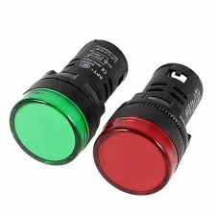
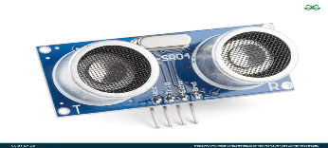
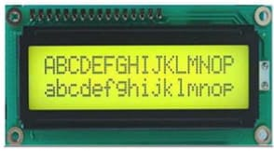
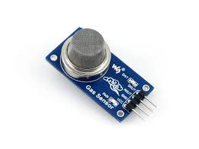
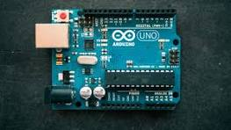
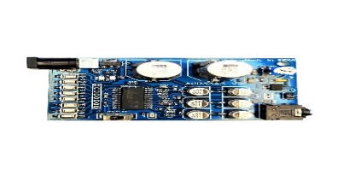
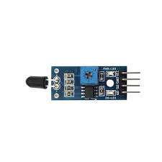
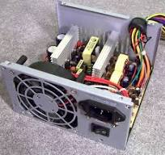
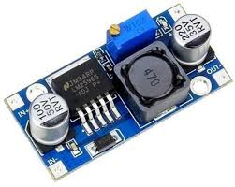
VEHICLE TO VEHICLE COMMUNICATION USING LIFI TECHNOLOGY
Ultrasonic Sensor
LED Indicator
LED インジケーター
ちょうおんぱ センサー
Arduino UNO
LCD Display
Gas Sensor
えきしょう ディスプレイ
アルドゥイーノ・ウノ
ガス センサー
APR33A3 Voice Module
Fire Sensor
おんせい モジュール
ほのお センサー
Battery Power Supply
バッテリー でんげん
Presented by:
Munnam Bhavya
23P31A04H1
でんしつうしんこうがく(ECE)
アディティア大学
LM2596 Voltage Regulator
こうあつ レギュレーター

Slide 2
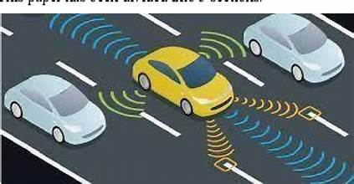
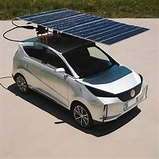
OBJECTIVE
Our system emergencies, affected vehicles transmit distress signals via Li-Fi, instantly alerting nearby vehicles through an LCD display and voice notifications.
METHODOLOGY
TRANSMITTER VEHICLE
Arduino UNO (Signal Decoding Unit)
LCD Display (Local Warning)
Sensors (Ultrasonic, Gas, Fire, Vibration, Panic Button)
Li-Fi Transmitter (LED Modulation)
LCD Display (Alert Message)
Arduino UNO (Signal Processing Unit)
Li-Fi Communication
RECEIVER VEHICLE Solar Panel (Li-Fi Light Receiver)
APR33A3 Voice Module + Speaker (Audio Alert)

Slide 3
BLOCK DIAGRAM
7805
voltage
Reachargeable
Lm2596
Rechargeable
regulator
battery
battery
Ultrasonic sensor
Ultrasonic sensor
Vibration sensor
Apr33a3 voice
speaker
Fire sensor
Vibration sensor
module
Arduino UNO
Gas sensor
Micro controller
Lcd
Arduino UNO
driver
Lcd display
Micro controller
Panic button
Lcd
Lcd display
transistor
LEDS
driver
Water spray
solar
Ultrasonic
Vibriate sensor
sensor
BLOCK DIAGRAM AT TRANSMITTER
BLOCK DIAGRAM AT RECEIVER

Slide 4
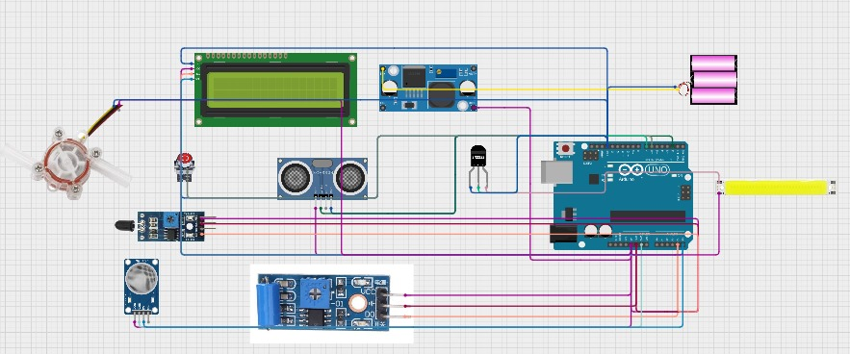
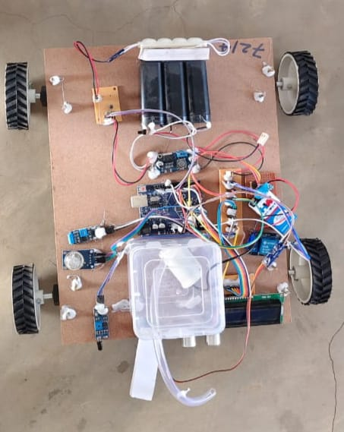
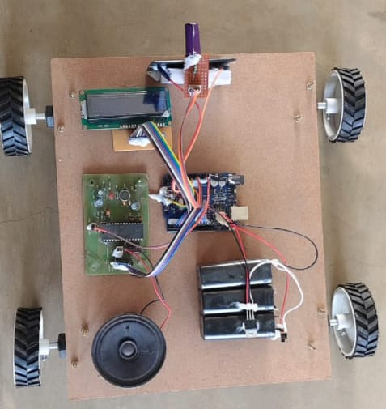
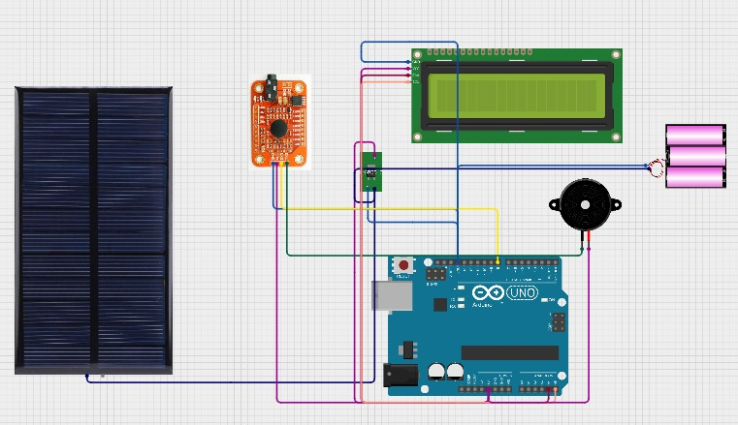

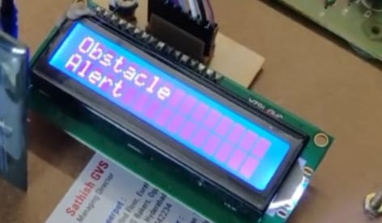
SCHEMATIC DIAGRAM
RESULTS
TRANSMITTER
TRANSMITTER
RECEIVER
(じゅしんき)
(そうしんき)
(そうしんき)
RECEIVER
(じゅしんき)

Slide 5
CONCLUSION AND FUTURE SCOPE
CONCLUSION
LIFI technology allows vehicles to communicate using light, providing fast, secure, and interference-free data transfer.
It improves road safety by enabling real-time alerts and reducing accidents.
Unlike RF or WIFI, LIFI reduces network congestion and offers better security.
Challenges include dependence on light and weather conditions like fog or sunlight.
FUTURE SCOPE
Integration with 5G & AI can make LIFI based communication faster and smarter.
Hybrid systems combining LIFI with RF can ensure continuous connectivity.
LIFI has great potential to improve future transportation, making roads safer and smarter.

Slide 6

ありがとうございます

